Slide 1
Enabling genetic technologies for food security
- The Precision Breeding Act is a great step forward for using gene editing for crop improvement: thanks HMG and civil service!
- Like GE, GM is a great method to raise and protect crop yields, replace chemistry with genetics
- 40 years of experience with GM show method no more risky than plant breeding
- Implementation of GM rules in the EU is dysfunctional
- However, the rules themselves allow for discretion by regulators on derogation for some components of the dossier
- Outside the EU, we can implement EU regulations more proportionately
Jonathan Jones, TSL, Norwich, UK and Jonny Hazell, RoySoc
http://www.tsl.ac.uk/groups/jones-group/
@jonathandgjones

Slide 2
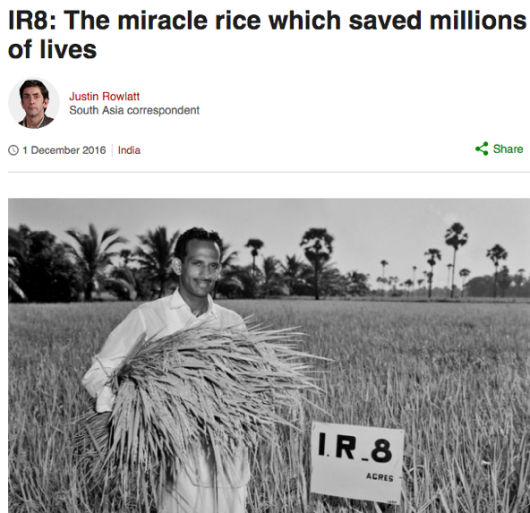
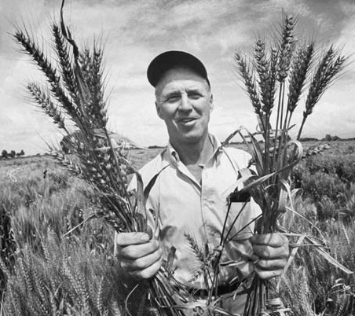
Without high-yielding varieties, food prices would be higher, we would need more land for agriculture
Norman Borlaug and rust resistant dwarf wheat
Producing food is hard- high yield is good! (reduces land for ag.)
Same area for ag. as in the ‘60s; >2x more yield
We need every tool in the toolbox

Slide 3
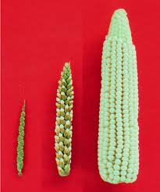
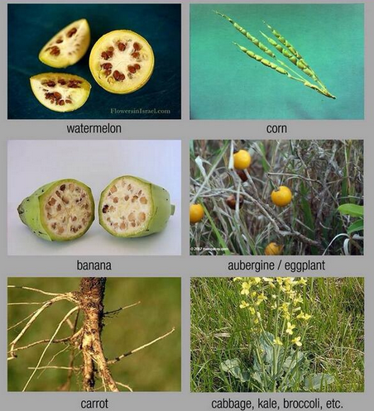
Crop performance depends on plant breeding
We have “genetically modified” crops for a long time
Most crops are barely recognizable in their ancestors; they have already been genetically modified.
- It was “unnatural” to move maize, tomato, potato, sunflower from S. America to Europe, where they were never grown
- So what can we do with the GM method?

Slide 4
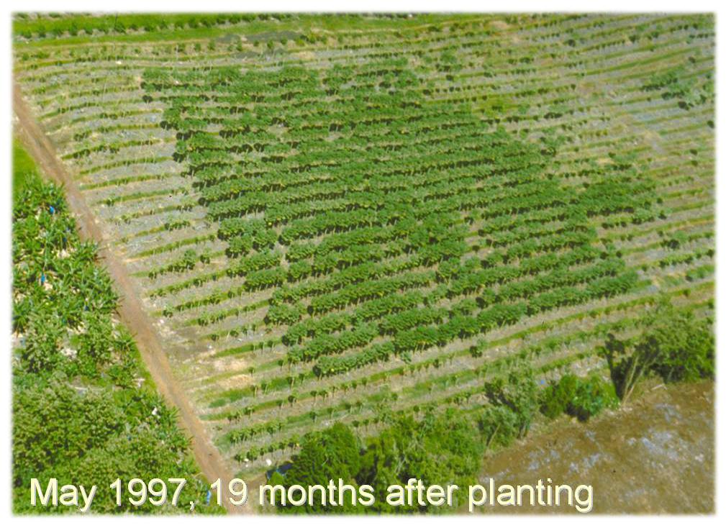
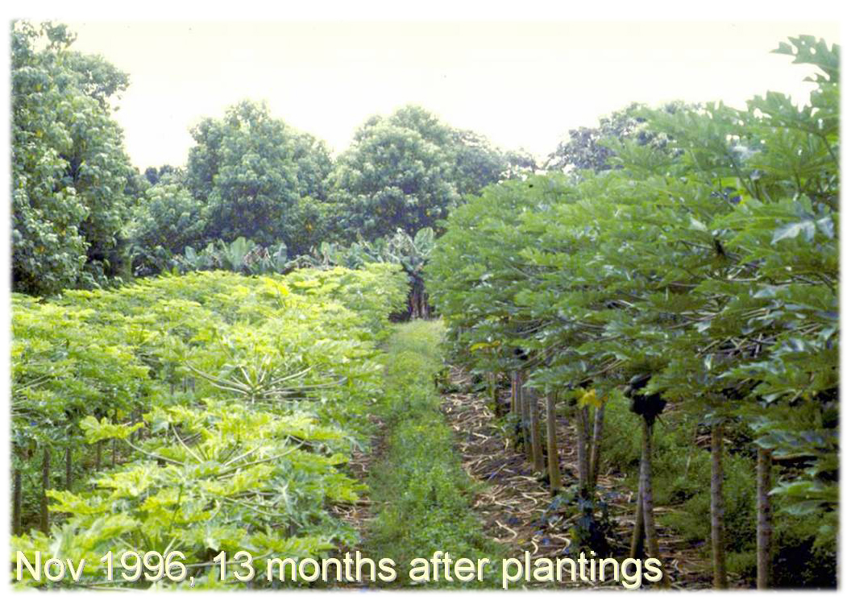
Engineered virus resistance in Hawaii saved the Hawaiain papaya industry
(public sector project, given to growers)

Slide 5
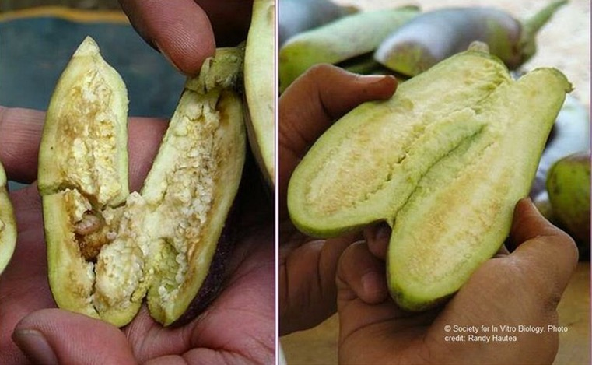
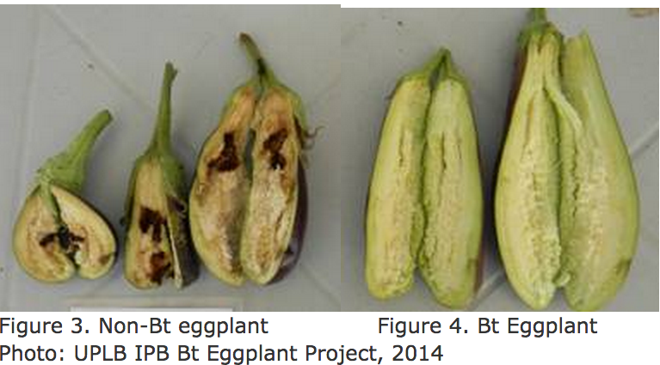
Bt Eggplant in Bangladesh
“Bt brinjal has been very effective against the key pest
– the fruit and shoot borer,”
Mohammad Rafiqul Islam Mondal, Director-General, BARI.
(not achievable with editing)
Bt maize and cotton reduce insecticide use in US and elsewhere
http://www.isaaa.org/resources/publications/pocketk/48/default.asp

Slide 6
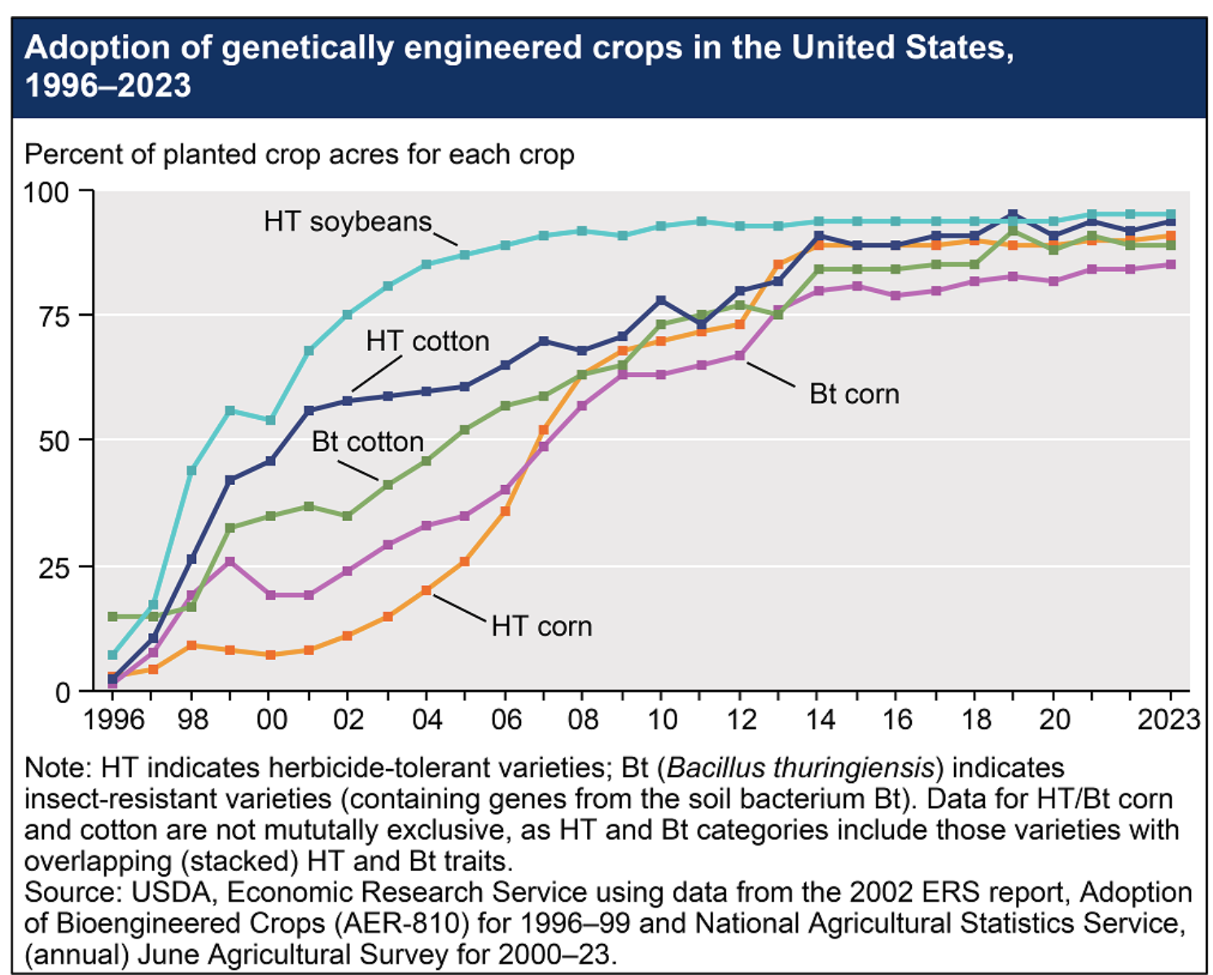

Slide 7
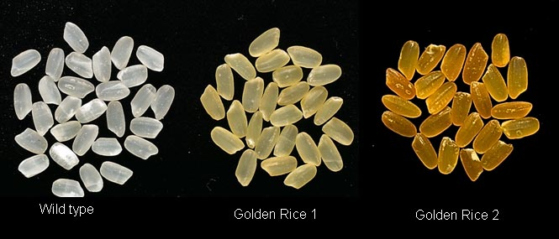
Golden Rice (Phytoene synthase and Carotene desaturase)
-vitamin A deficiency blinds 500,000 children per year; most die
-Single most important cause of blindness in the developing world
250 million children are vitamin A deficient

Slide 8
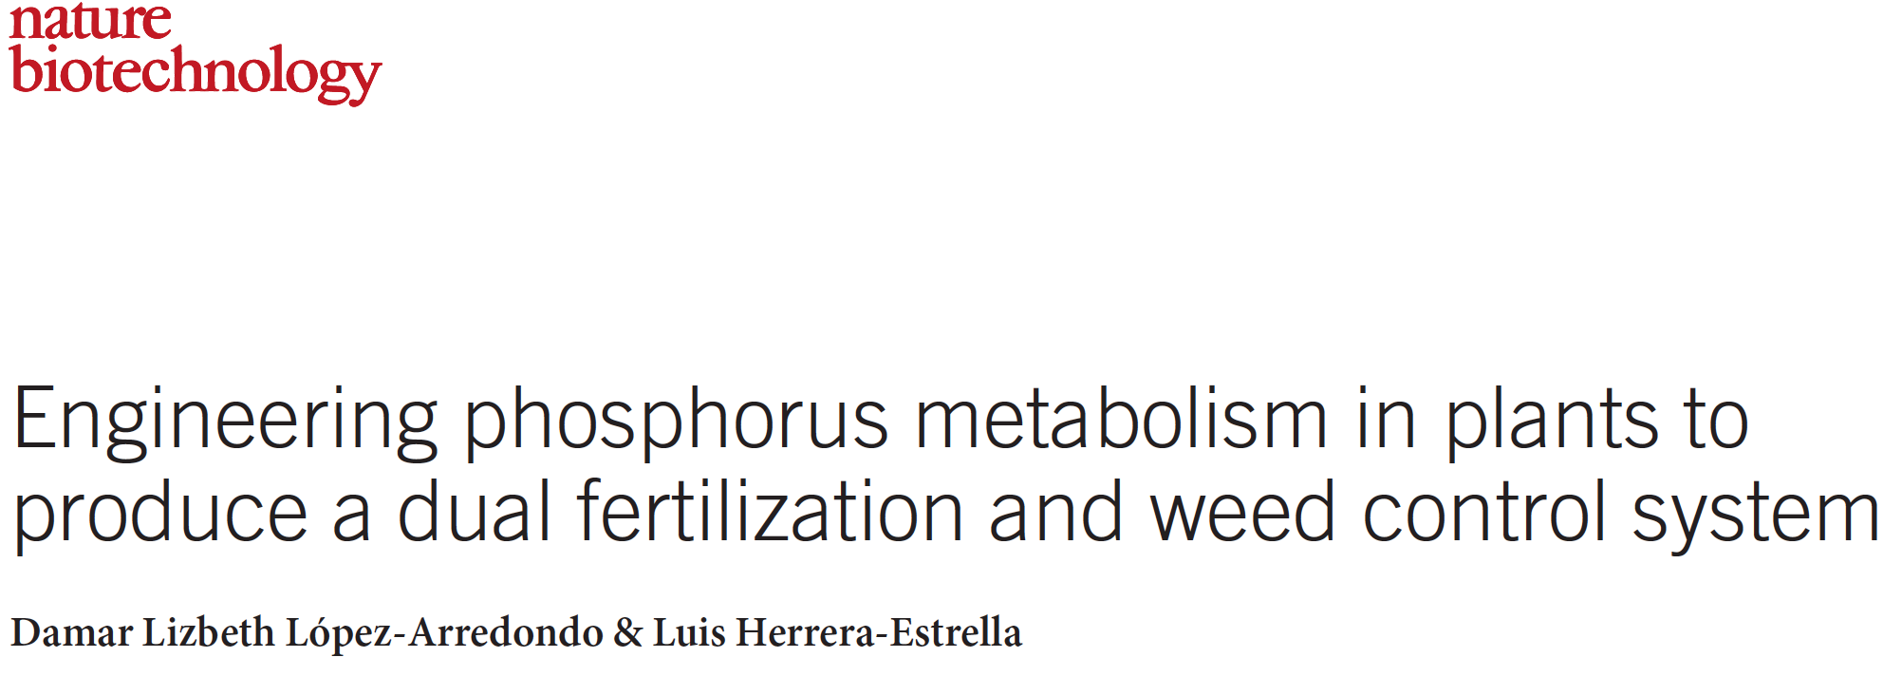
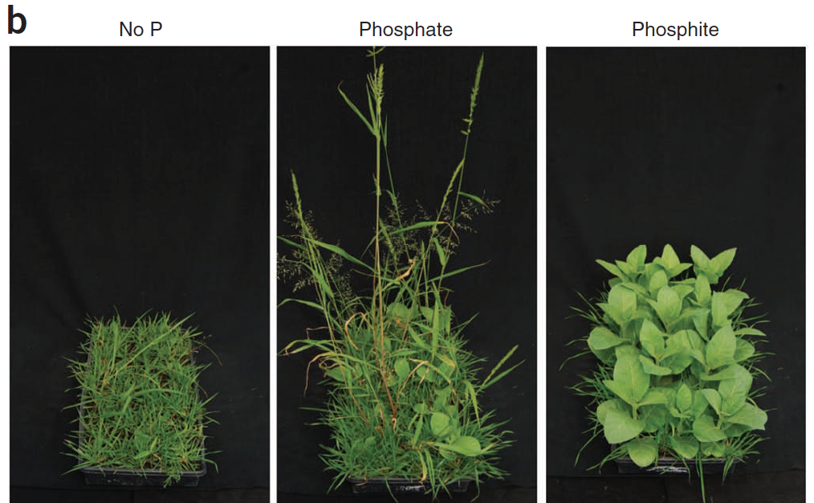
Phosphite utilization for weed control
Plants can’t use phosphite unless they make bacterial enzyme PtxD
Crop outcompetes weeds by using phosphite that weed can’t use
Phosphite also suppresses root pathogens
PO₄
grass weed wins
PO₃ tobacco crop wins
No P
(not achievable with editing)

Slide 9
What you need to know about genes
Most plants carry >30,000 genes
Genes mostly encode the amino acid sequence of a protein
Proteins are tiny machines that do a chemical job (enzymes) or a physical job (eg muscle proteins)
Mutations in genes alter or lose protein function
Crops and their ancestors carry enormous genetic variation, used by plant breeders

Slide 10
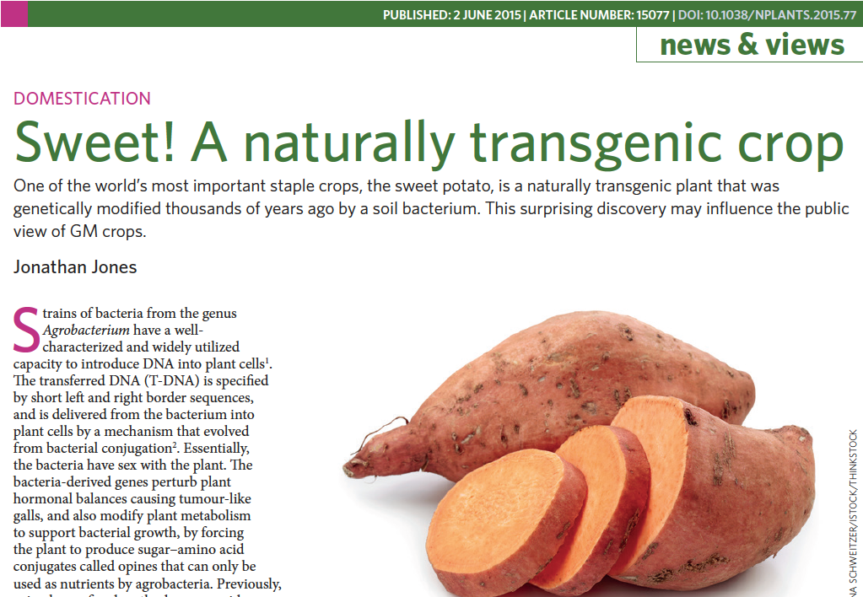
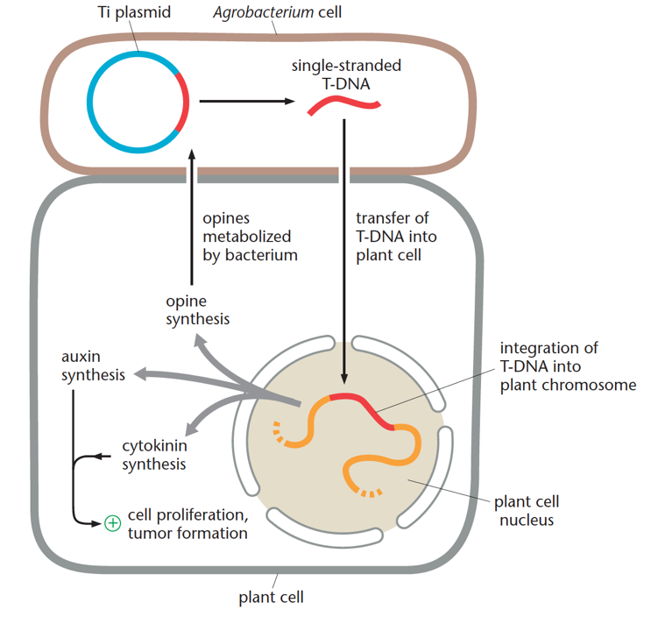
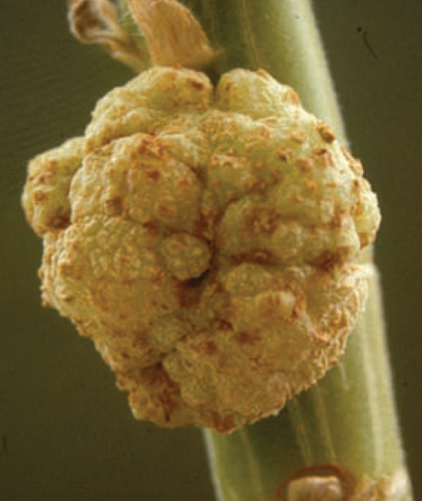
A nature-based solution; how to add DNA to a plant chromosome
A typical plant genome has several chromosomes
Crown gall

Slide 11
GM is a method, not a thing
After you add an App to your Iphone, it’s still an Iphone, but with added function
After you add a gene to a potato with 60,000 genes, it’s still a potato, but with added function
All learned societies conclude, the method is safe, and on balance, benign
(No “unknown unknowns”)

Slide 12
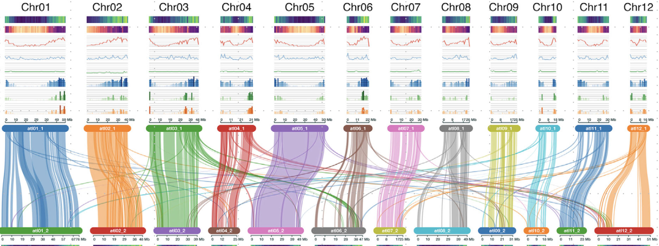
Huge genetic variation within any species
The scale and extent of this enormous variation only became clear in the last ten years of genomics
Potato chromosomes
Changes introduced by GM or GE are tiny compared to the massive structural and allelic variation in any plant genome
We have lost all sense of proportion

Slide 13
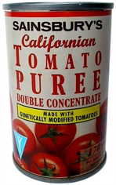
GM wasn’t always controversial
A UK perspective

Slide 14
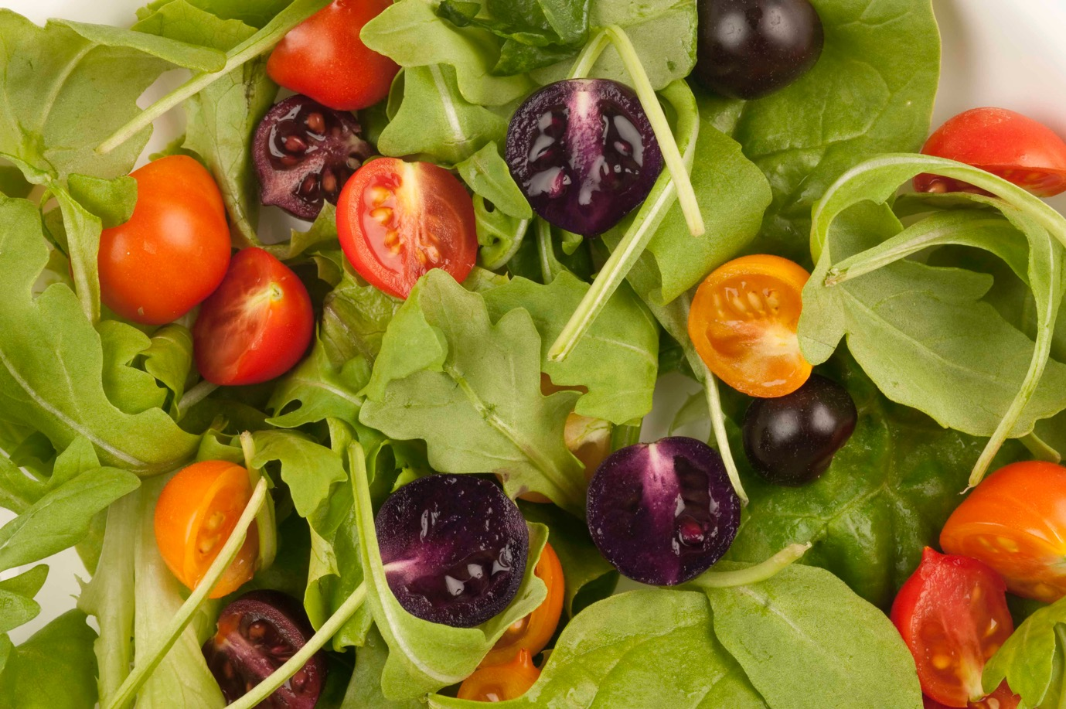
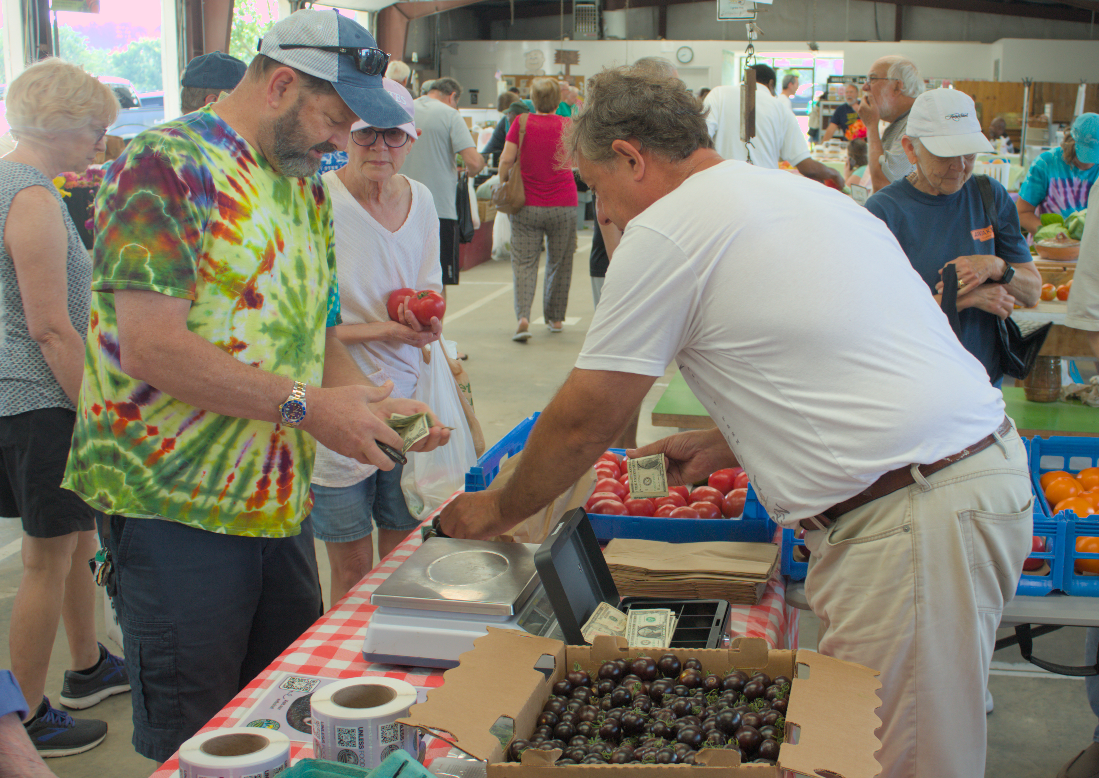
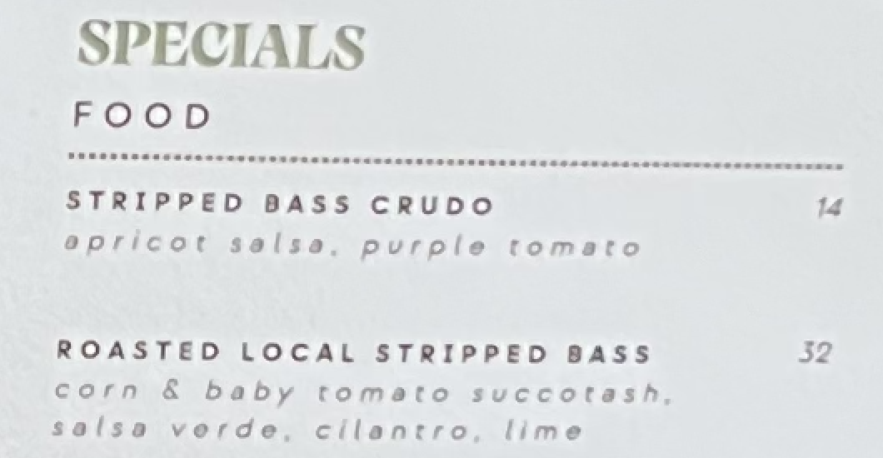
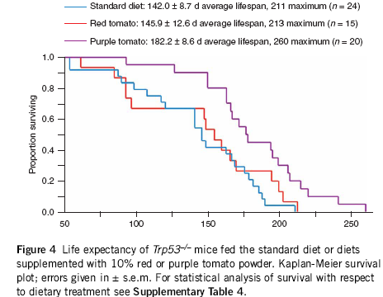
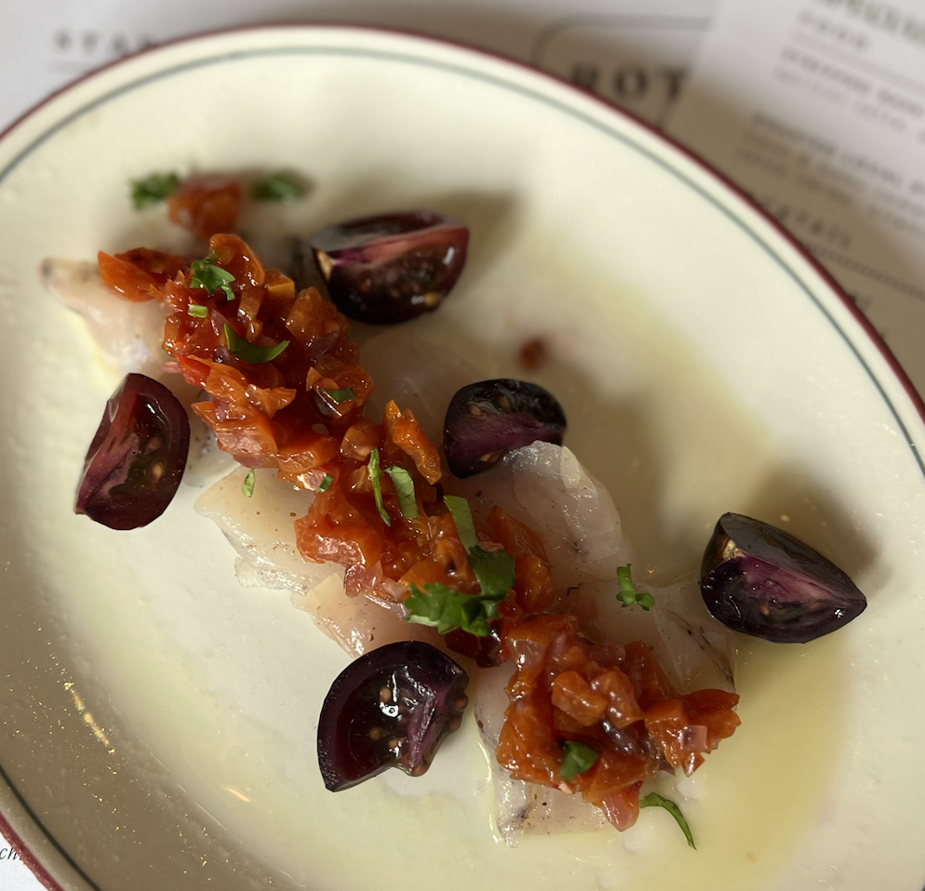
Nutritional enhancement via GM in the purple tomato
(not achievable with editing)

Slide 16
How do plants resist disease?
All plants carry 100s to 1000s of immune receptors that detect pathogens and activate defence
Incompletely overlapping immune receptor repertoires, within and between species
Immune receptors plant 1
Move immune receptors from plant 1 to plant 2:
increase its resistance
Immune receptors plant 2

Slide 17
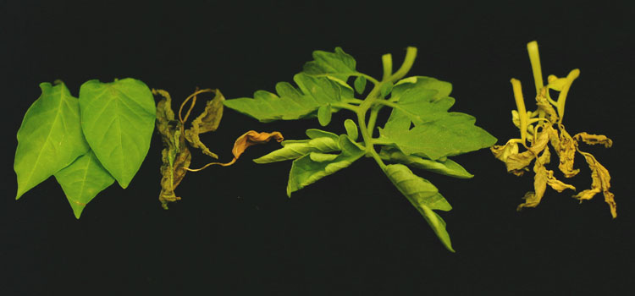
Pepper Bs2 gene confers bacterial resistance in tomato;
Doubles the yield in Florida fields
Pepper
Tomato
Bs2 (+)
Bs2 (-)
Bs2 (+)
Bs2 (-)

Slide 18
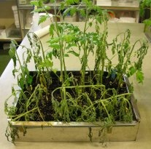
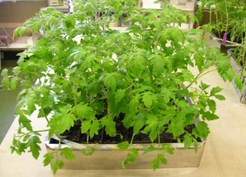
The Arabidopsis EFR gene can save tomato from bacterial wilt (Ralstonia)
(not achievable with editing)
Ralstonia (bacterial wilt) resistance from Arabidopsis EFR in tomato
MM 35S::EFR
MoneyMaker WT
Nat Biotech April 2010
Dozens of other potentially useful GM traits, that could solve crop problems with genetics not chemistry, are blocked by excessive regulation

Slide 19
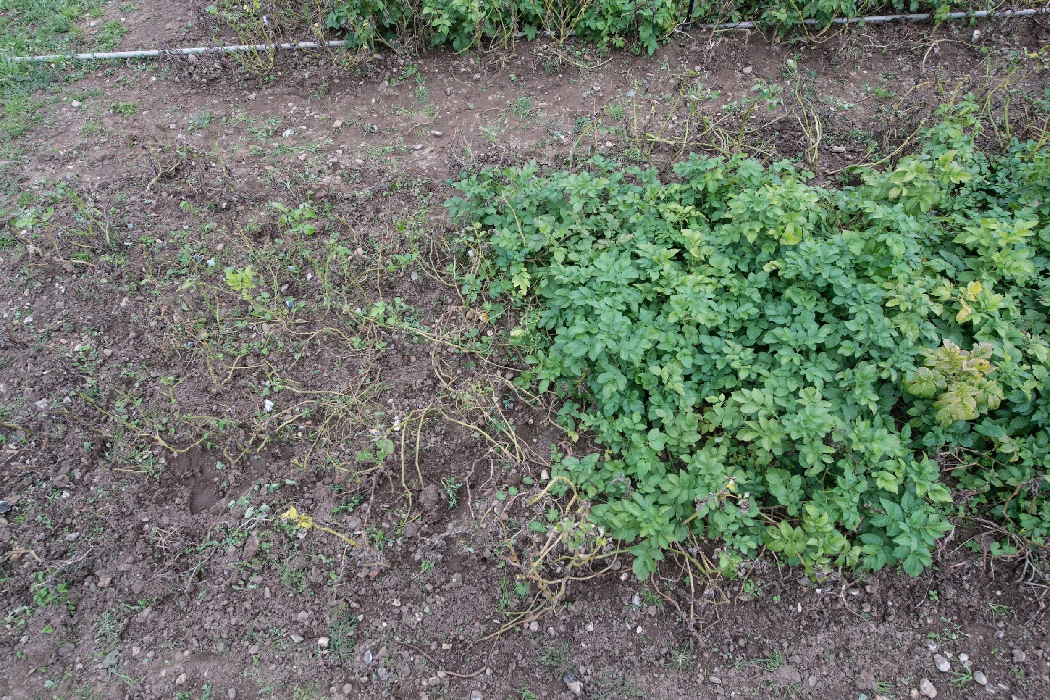
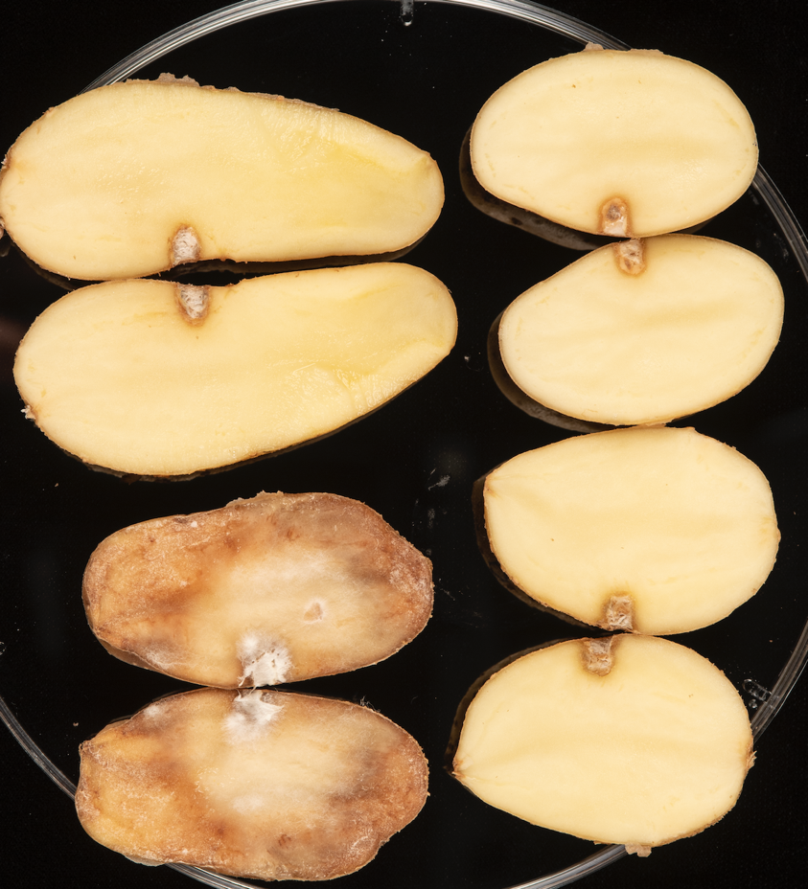
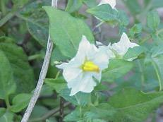
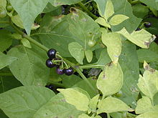
Gene stack with 3 Rpi genes from wild potatoes confers complete field resistance against all tested UK blight races
Control
3x Rpi stack
CS^{R}
Rpi-vnt1
Rpi-amr3
Rpi-amr1
silence PPO, INV
Solanum venturii
Solanum americanum
No yield penalty, complete tuber blight resistance
Marina Pais
Kamil Witek
Notes:
All the genes cloned with their native regulatory elements.
Rpi-vnt1 already tested in the field.
S. americanum
Non-tuberizing
Diploid
Originaria del continente americano, desde el sur y noroeste de los Estados Unidos hasta Paraguay y Perú, incluidas las islas del Caribe. Sometimes consumed as food but may have toxic compounds.
Unable to cross with S. tuberosum
Rpi-amr3 comes from accession SP1102 / Chr. 4
Rpi-amr1e comes from accession SP2273 / Chr. 11
S. venturii
Tuberizing
Diploid
Originaire d'Argentine (Endémique des provinces du nord-ouest de l'Argentine, qui se rencontre entre 1900 et 3000 mètres d'altitude dans les régions de Catamarca, Jujuy, La Rioja, Salta et Tucumán).
Able to cross with S. tuberosum 2n (not straightforward anyway) but not with cultivated 4n varieties
Rpi-vnt1 comes from Chr. 9

Slide 20
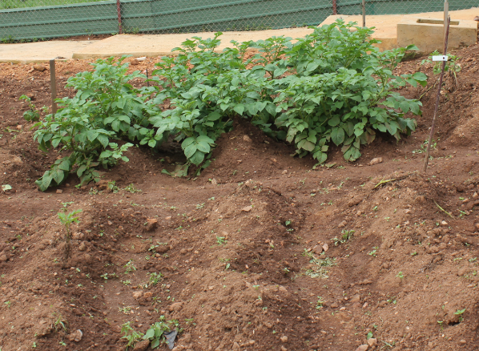
Rpi-vnt1 with Rpi-blb1,blb2 confer late blight resistance in a field trial in Uganda
GM Victoria completely unaffected by late blight
Non-GM Desiree completely devastated by late blight disease

Slide 21
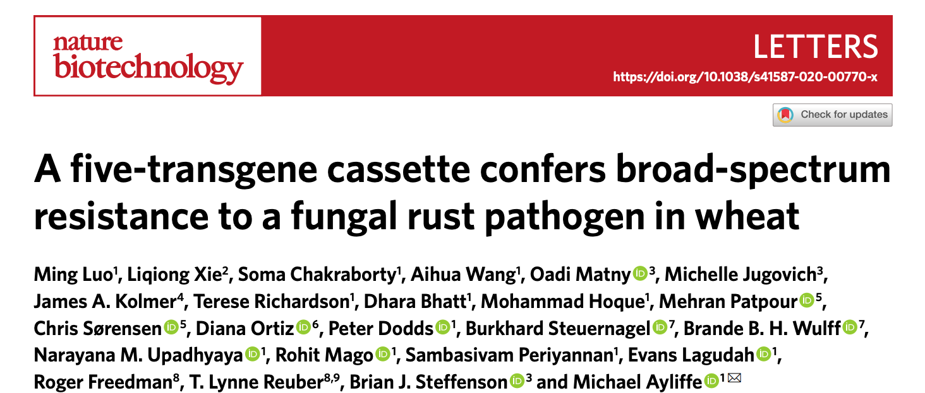
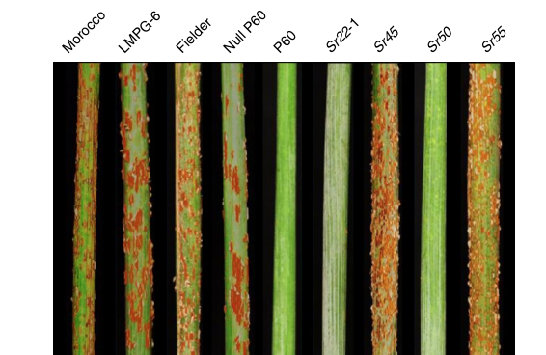
(not achievable with simple editing)
Stacking R genes works for rust control too

Slide 22
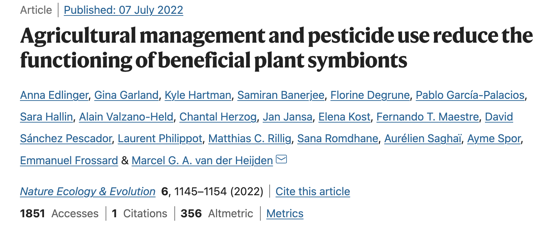
We should protect crops with genetics not chemistry:
no damage to mycorrhizal fungi, less AMR in human fungal pathogens

Slide 23
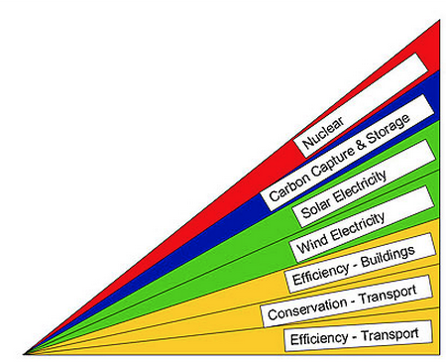
How to address a big problem; the wedge concept Many useful methods, let’s avoid false antitheses
Energy security, climate change
Food security,
climate change
Reduced meat consumption
Reduced food waste
Better agronomy: intercropping
Better agronomy: low till
Better genetics: editing
Better genetics: GM
Better genetics: breeding

Slide 24
GM a useful method to help pest, disease and weed control, reduce environmental impact, and enhance nutrition
Never before such extensive regulation on the basis of completely hypothetical hazards or risks
The pre-cautionary principle needs to be time-limited;
we need a “post-cautionary” principle for when uncertainty is replaced by certainty. When the facts change (or appear) we can change our minds
Regulatory costs stop small companies and the public sector from bringing forward useful GM traits; this slows economic growth
Big opportunity cost of “roads not taken”; we talk ourselves out of solutions with “GM products are impossible”

Slide 25
GM a useful method to help pest, disease and weed control, reduce environmental impact, and enhance nutrition
Never before such extensive regulation on the basis of completely hypothetical hazards or risks
The pre-cautionary principle needs to be time-limited;
we need a “post-cautionary” principle for when uncertainty is replaced by certainty. When the facts change (or appear) we can change our minds
Regulatory costs stop small companies and the public sector from bringing forward useful GM traits; this slows economic growth
Big opportunity cost of “roads not taken”; we talk ourselves out of solutions with “GM products are impossible”

Slide 26
GM a useful method to help pest, disease and weed control, reduce environmental impact, and enhance nutrition
Never before such extensive regulation on the basis of completely hypothetical hazards or risks
The pre-cautionary principle needs to be time-limited;
we need a “post-cautionary” principle for when uncertainty is replaced by certainty. When the facts change (or appear) we can change our minds
Regulatory costs stop small companies and the public sector from bringing forward useful GM traits; this slows economic growth
Big opportunity cost of “roads not taken”; we talk ourselves out of solutions with “GM products are impossible”

Slide 27
GM a useful method to help pest, disease and weed control, reduce environmental impact, and enhance nutrition
Never before such extensive regulation on the basis of completely hypothetical hazards or risks
The pre-cautionary principle needs to be time-limited;
we need a “post-cautionary” principle for when uncertainty is replaced by certainty. When the facts change (or appear) we can change our minds
Regulatory costs stop small companies and the public sector from bringing forward useful GM traits; this slows economic growth
Big opportunity cost of “roads not taken”; we talk ourselves out of solutions with “GM products are impossible”

Slide 28
GM a useful method to help pest, disease and weed control, reduce environmental impact, and enhance nutrition
Never before such extensive regulation on the basis of completely hypothetical hazards or risks
The pre-cautionary principle needs to be time-limited;
we need a “post-cautionary” principle for when uncertainty is replaced by certainty. When the facts change (or appear) we can change our minds
Regulatory costs stop small companies and the public sector from bringing forward useful GM traits; this slows economic growth
Big opportunity cost of “roads not taken”; we talk ourselves out of solutions by saying “GM products are impossible”

Slide 29
GM a useful method to help pest, disease and weed control, reduce environmental impact, and enhance nutrition
Never before such extensive regulation on the basis of completely hypothetical hazards or risks
The pre-cautionary principle needs to be time-limited;
we need a “post-cautionary” principle for when uncertainty is replaced by certainty. When the facts change (or appear) we can change our minds
Regulatory costs stop small companies and the public sector from bringing forward useful GM traits; this slows economic growth
Big opportunity cost of “roads not taken”; we talk ourselves out of solutions with “GM products are impossible”
Time to move on from the “GE good, GM bad” narrative;
they’re both good

Slide 30
How do we do that?
Over to you Jonny

